Slide 1

INTRODUCTION TO OPTIMIZATION
NON-LINEAR PROGRAMMING
-Problems with Equality Constraints-

Slide 2
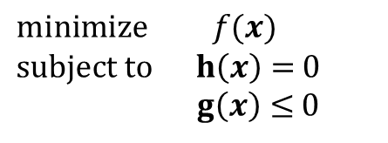
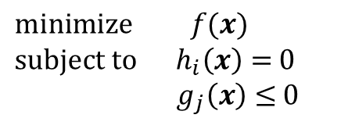

* Non- Linear Programs(Equality Constraints)
• Nonlinear problems - $ℝ^{n}$
$$minimize f(x)$$
$subject to h_{i}\left(x\right)=$ 0
$g_{j}\left(x\right)≤$ 0
$$i=1,…,m$$
$$j=1,…,p$$
Where → $x∈ℝ^{n}, f:ℝ^{n}→ℝ^{}, h_{i}:ℝ^{n}→ℝ^{}, g_{j}:ℝ^{n}→ℝ^{}$ and m $≤$n
• In vector notation
$$minimize f(x)$$
$subject to h\left(x\right)=$ 0
$g\left(x\right)≤$ 0
Where → $h:ℝ^{n}→ℝ^{m}, g_{j}:ℝ^{n}→ℝ^{p}$

Slide 3

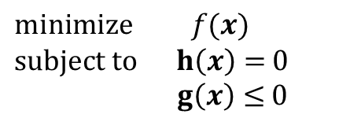

* Non- Linear Programs(Equality Constraints)
• Definition 20.1
Any point satisfying the constraints is called a feasible point The set of all feasible points,
{$x∈ℝ^{n} :h\left(x\right)=0, g\left(x\right)≤0\}$
is called a feasible set.
$$minimize { c}^{T}x$$
$$subject to Ax=b$$
$x≥0$
$$minimize f(x)$$
$subject to h\left(x\right)=$ 0
$g\left(x\right)≤$ 0
Linear programming problems of the form
Non-Linear programming problems of the form
It can easily be transformed into the minimization problem by observing that
maximize : $f\left(x\right)$ = minimize : $−f(x)$

Slide 4
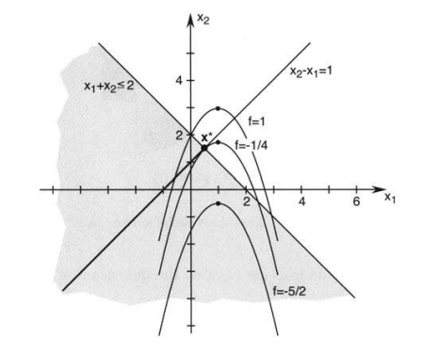
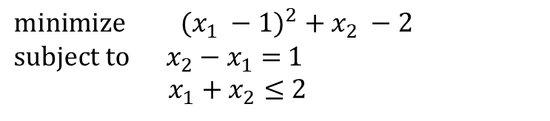




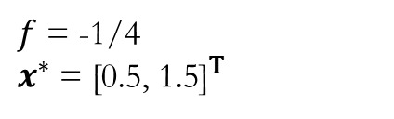
* Non- Linear Programs(Equality Constraints)
• Example 20.1
$$x∈ℝ^{2}$$
$$minimize {(x_{1} −1)}^{2} + x_{2} −2$$
$subject to x_{2}−x_{1}=$ 1
$x_{1}+x_{2}≤$ 2
$$f\left(x_{1},x_{2}\right)={\left(x_{1} −1\right)}^{2} + x_{2} −2$$
$$h\left(x_{1},x_{2}\right)=x_{2}−x_{1}−\text{ 1}$$
$$g\left(x_{1},x_{2}\right)=x_{1}+x_{2}−\text{ 2}$$
$f$ = -1/4
$x^{∗}$ = ${\text{[0.5, 1.5]}}^{T}$
feasible set

Slide 5
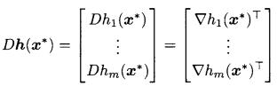

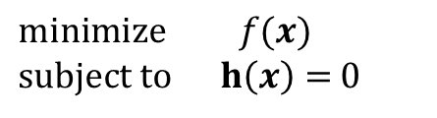
* Non- Linear Programs(Equality Constraints)
Problem Formulation
The class of optimization problems we analyze in this chapter is
$$minimize f(x)$$
$subject to h\left(x\right)=$ 0
Where → $x∈ℝ^{n}, f:ℝ^{n}→ℝ^{},h:ℝ^{n}→ℝ^{m},h={[h_{1}, …,h_{m}]}^{T}$ and m $≤$n
We assume that the function $h$ is continuously differentiable
• Definition 20.1
A point $x^{∗}$ satisfying the constraints $h_{1}$($x^{∗}$) = 0,..., $h_{m}$($x^{∗}$) = 0 is said to be a regular point of the constraints if the gradient vectors ${∇h}_{1}$($x^{∗}$),..., ${∇h}_{m}$($x^{∗}$) are linearly independent.

Slide 6
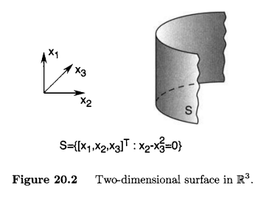
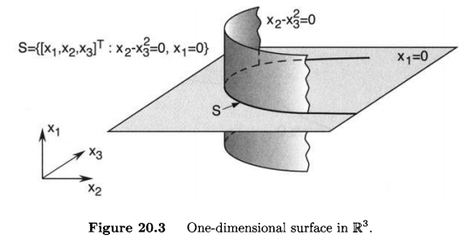









* Non- Linear Programs(Equality Constraints)
Problem Formulation
• Definition 20.2
Let n = 3 and m = 1 (i.e., we are operating in $ℝ^{3}$). Assuming that all points in S are regular, the set S is a two-dimensional surface. For example, let
$h_{1}$($x$) = $x_{2} − x_{3}^{2}$
${∇h}_{1}$($x$) = ${[0, 1, −2x_{3}^{}]}^{T}$
$x∈ℝ^{3}$, ${∇h}_{1}$($x$) $≠$ 0
dim S = dim{$x:h_{1}$($x$) = 0} = n - m = 2
Let n = 3 and m = 2 (i.e., we are operating in $ℝ^{3}$). Assuming that all points in S are regular, the set S is a two-dimensional surface. For example, let
$h_{1}$($x$) = $x_{1}$
$h_{2}$($x$) = $x_{2} − x_{3}^{2}$
${∇h}_{1}$($x$) = ${[1, 0, 0]}^{T}$
${∇h}_{2}$($x$) = ${[0, 1, −2x_{3}^{}]}^{T}$
dim S = dim{$x:h_{1}$($x$) = 0, $h_{2}$($x$) = 0} = n - m = 1

Slide 7
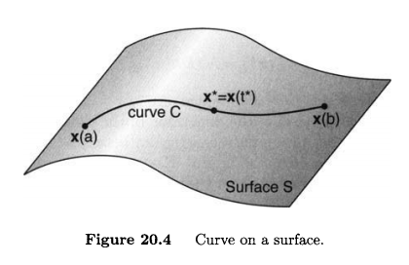

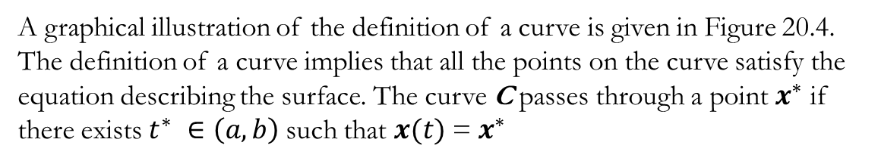
* Non- Linear Programs(Equality Constraints)
Tangent and Normal Spaces
In this section we discuss the notion of a tangent space and normal space at a point on a surface. We begin by defining a curve on a surface S.
• Definition 20.3
A curve C on a surface S is a set of points {$x(t)∈S$, $t ∈(a,b)$} continuously parameterized by $t ∈\left(a,b\right);$that is, $x$ : $\left(a,b\right)$—» S is a continuous function.
A graphical illustration of the definition of a curve is given in Figure 20.4.
The definition of a curve implies that all the points on the curve satisfy the
equation describing the surface. The curve C passes through a point $x^{∗}$ if
there exists $t^{∗} ∈\left(a,b\right)$such that $x(t)$= $x^{∗}$
C = {$x\left(t\right) : t ∈\left(a,b\right)\}$

Slide 8
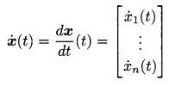
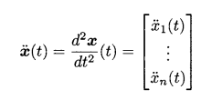
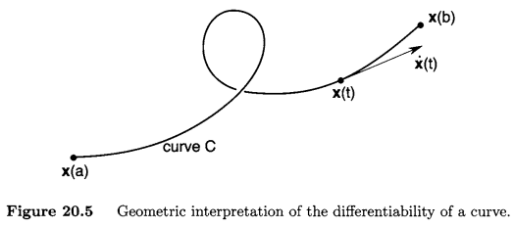
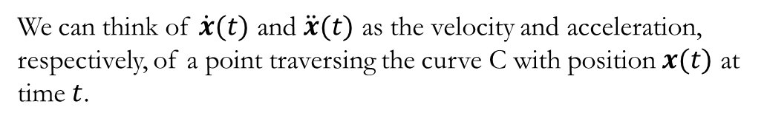
* Non- Linear Programs(Equality Constraints)
• Definition 20.4
C = {$x\left(t\right) : t ∈\left(a,b\right)\} is differentiable if exists for all t ∈\left(a,b\right)$.
C = {$x\left(t\right) : t ∈\left(a,b\right)\} is twice differentiable if exists for all t ∈\left(a,b\right)$.
We can think of $\dot{x}(t)$ and $\ddot{x}(t)$ as the velocity and acceleration, respectively, of a point traversing the curve C with position $x(t)$ at time $t$.

Slide 9

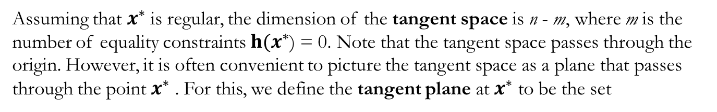
* Non- Linear Programs(Equality Constraints)
• Definition 20.5
The tangent space at a point $x^{∗}$ on the surface S = {$x∈ℝ^{n}, h\left(x\right)=$ 0} is the set
T($x^{∗}$ ) = {$y$ : $𝒟h(x^{∗}$)y = 0}.
Assuming that $x^{∗}$ is regular, the dimension of the tangent space is n - m, where m is the number of equality constraints $h(x^{∗}$) = 0. Note that the tangent space passes through the origin. However, it is often convenient to picture the tangent space as a plane that passes through the point $x^{∗}$ . For this, we define the tangent plane at $x^{∗}$ to be the set

Slide 10
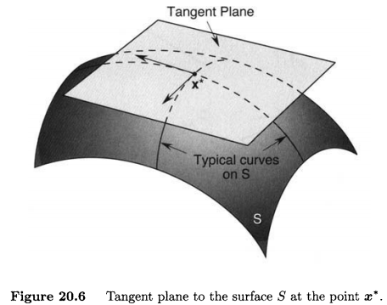
* Non- Linear Programs(Equality Constraints)
• Definition 20.5

Slide 11




* Non- Linear Programs(Equality Constraints)
• Theorem 20.1
Suppose that $x^{∗}$ $∈$ S is a regular point and T($x^{∗}$) is the tangent space at $x^{∗}$ . Then, $y$ $∈$ T($x^{∗}$) if and only if there exists a differentiable curve in S passing through $x^{∗}$ with derivative $y$ at $x^{∗}$.
Proof <=: Suppose that there exists a curve {$x(t)∈S$, $t ∈(a,b)$} in S such that
$x(t^{∗})$= $x^{∗}$and $\dot{x}(t^{∗})$= $y$ for some $t^{∗}∈(a, b)$. Then,
$$h\left(x\left(t\right)\right)=0$$
for all $t^{}∈(a, b)$. If we differentiate the function $h\left(x\left(t\right)\right)$with respect to $t$ using the chain rule, we obtain
for all $t^{}∈(a, b)$. Therefore, at $t^{∗}$ we get
$y$ $∈$ T($x^{∗}$)

Slide 12
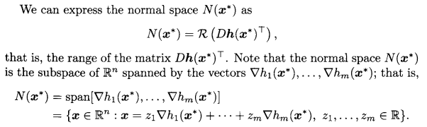
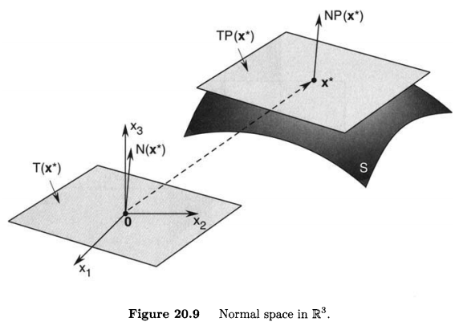

* Non- Linear Programs(Equality Constraints)
• Definition 20.6
The normal space N($x^{∗}$) at a point $x^{∗}$ on the surface S = {$x(t)∈S$, $t ∈(a,b)$} is the set N($x^{∗}$) = {$x∈ℝ^{n} : x= {𝒟h\left(x^{∗}\right)}^{T}z, z∈ℝ^{n}$} .

Slide 13
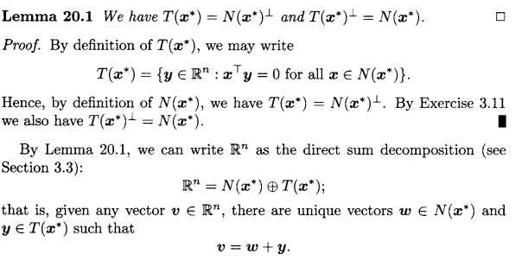
* Non- Linear Programs(Equality Constraints)

